Slide 1
Data Analysis 1 (python)
Reading files, summarising and describing data, Correlation and covariance
For any questions reach out to: kim.ta@barclays.com

Slide 2
Contents
Reading files
Importing libraries
Loading data
Summarising and describing data
Correlation and covariance

Slide 3
Reading files
In this section we will first learn how to read:
CSV files
Text files
Excel files
Files from a different working directory
Python built in datasets

Slide 4
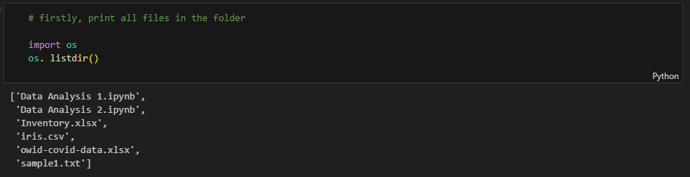


Slide 5
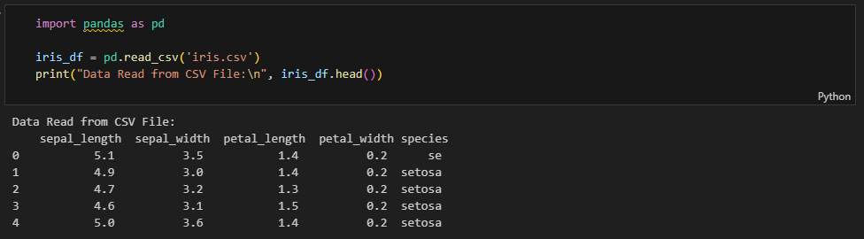
Reading a CSV file
Stores tabular data in plain text
Text file format that uses commas to separate values
Newlines to separate records
Typically each line represents one data record

Slide 6
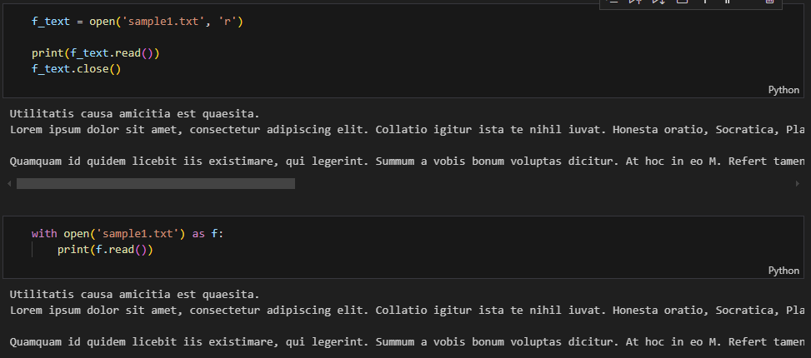
Reading a Text file
When working with files in Python, it is recommended to use the with context manager to open files. This ensures that the file is properly closed and the resources are released, regardless of whether the program runs successfully or an exception occurs during the file operations.

Slide 7
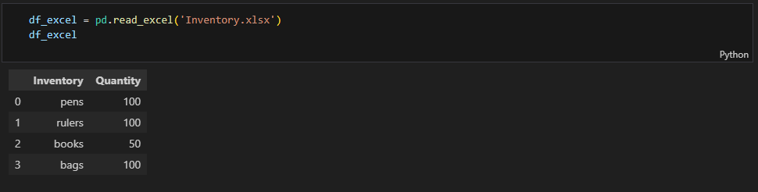
Reading an Excel file

Slide 8
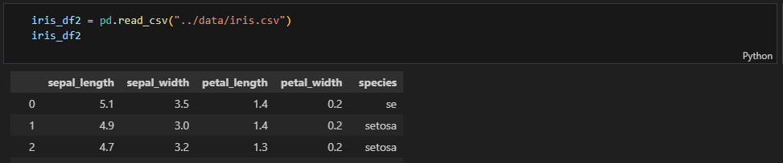
Reading data from a different working directory
Firstly, we'll learn how to read files from a folder different from the current working directory. Our file is currently in the folder "notebook" but we want to read a file from the folder "data". `Notebook -> Data`
Method 1: Include the file path, this is very simple
We specify the path to the "data" folder relative to our current working directory. If the "data" folder is located at the same level as the "notebook" folder, the relative path will be ../data.

Slide 9
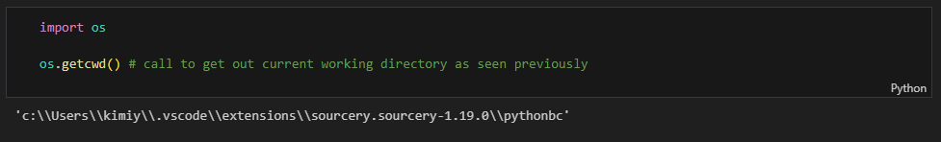
Method 2: change our working directory (useful to know)
This requires the os package which provides easy functions that allow us to interact and get Operating System information. For more information see https://docs.python.org/3/library/os.html
Where we:
Check Your Current Working Directory
Specify the Path to the Data Folder
Read the CSV File

Slide 10
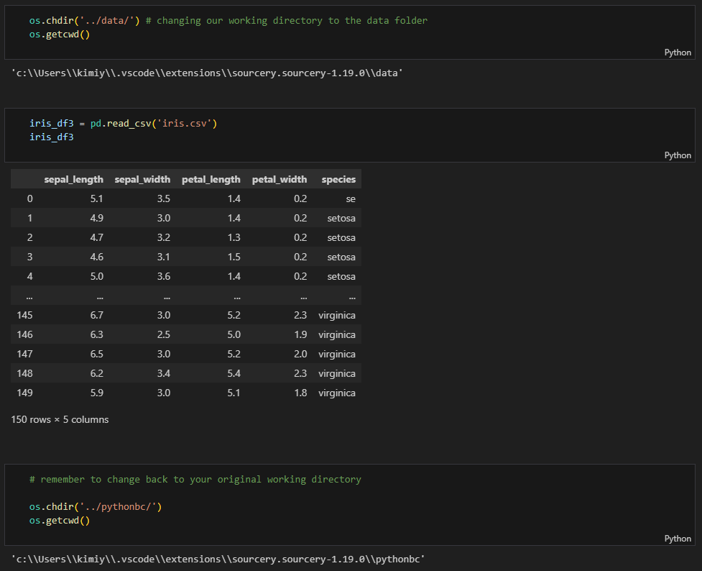

Slide 11
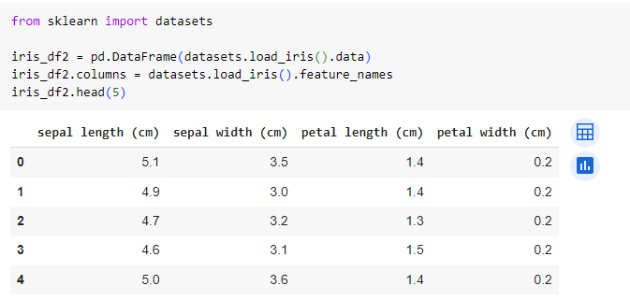
Python built in datasets

Slide 12
Summarising and describing Data
Descriptive statistics include:
Measures of central tendency (center position of a distribution for a data set)
mean, median and mode
Measures of variability or dispersion (spread of distribution)
variance or standard deviation, coefficient of variation, minimum and maximum values, IQR (Interquartile Range), skewness and kurtosis

Slide 13
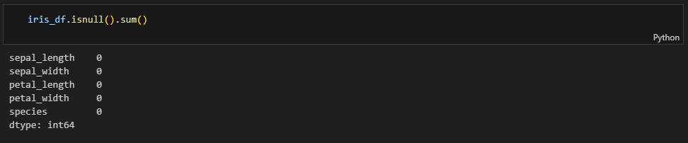
Checking for any null values

Slide 14
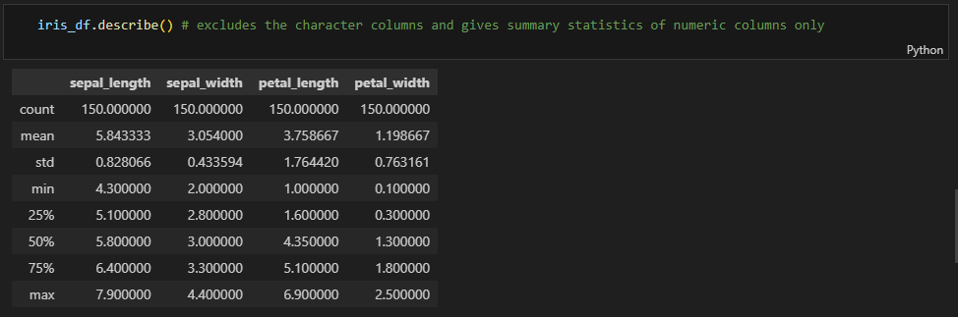
describe() function

Slide 15
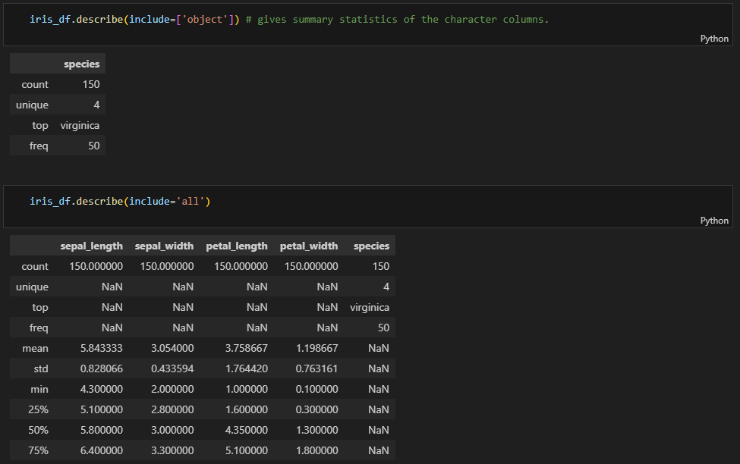

Slide 16
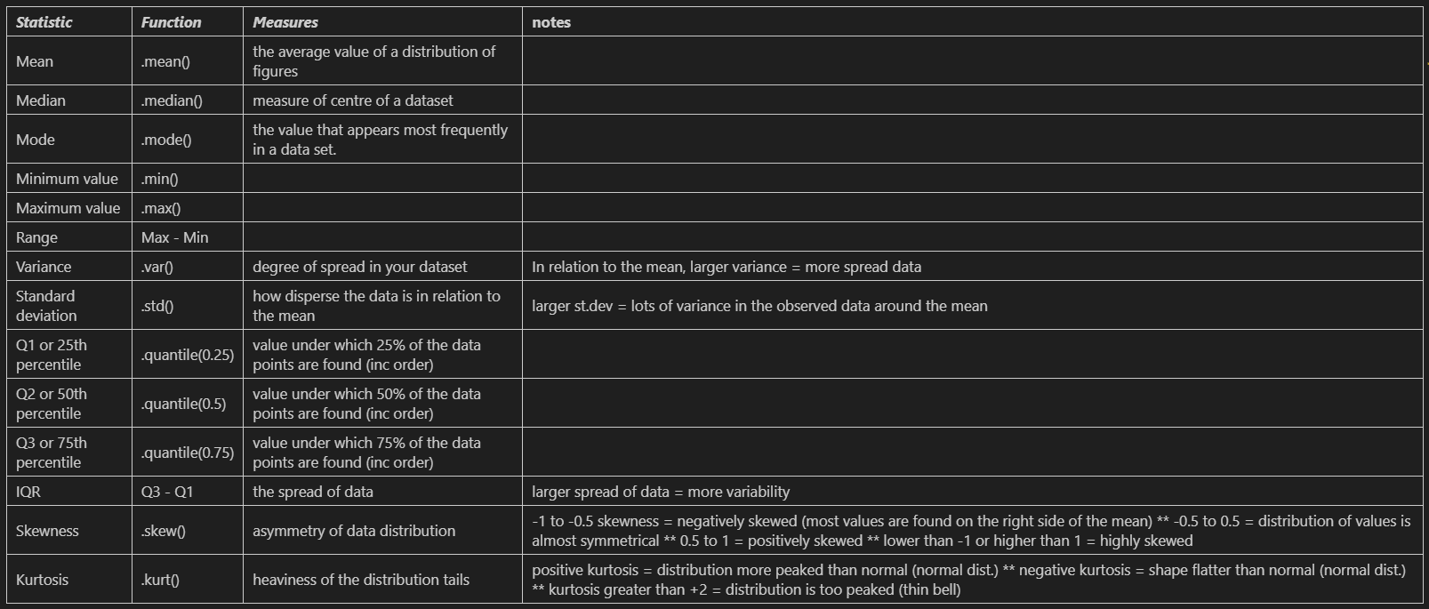
Different measures

Slide 17
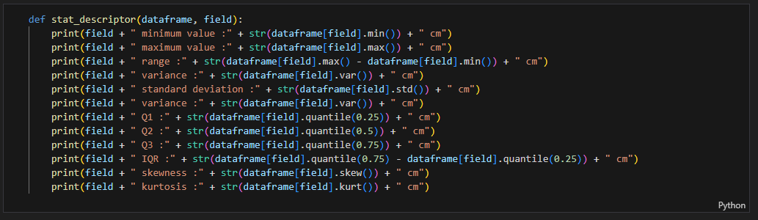
Quick function to show all basic statistical measures

Slide 18
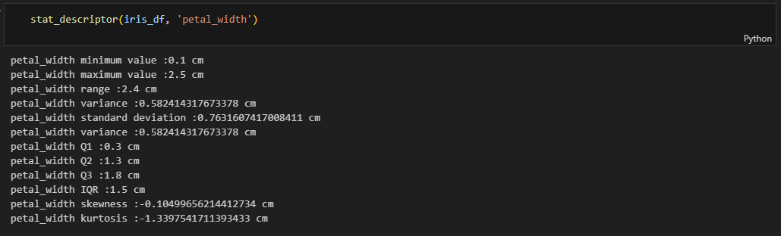

Slide 19
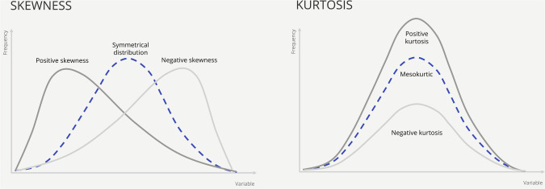
Skewness and Kurtosis
Skewness indicates the degree of tilt in data, whether it leans towards the left or right, exposing any asymmetry present. A positive skew indicates a tail extending towards the right, whereas a negative skew leans in the opposite direction. Kurtosis, on the other hand, focuses on the distribution's peaks and tails.

Slide 20
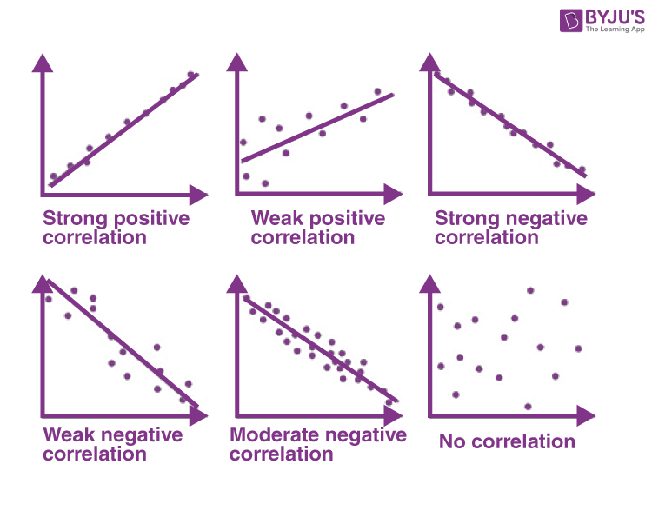
Correlation
standardized measure of the linear relationship between two variables
quantifies the strength and direction of the relationship on a scale from -1 to +1
+1 indicates a perfect positive linear relationship
-1 indicates a perfect negative linear relationship
0 indicates no linear relationship
unitless and not affected by the scale or units of the variable (easier to compare strength of relationship)

Slide 21
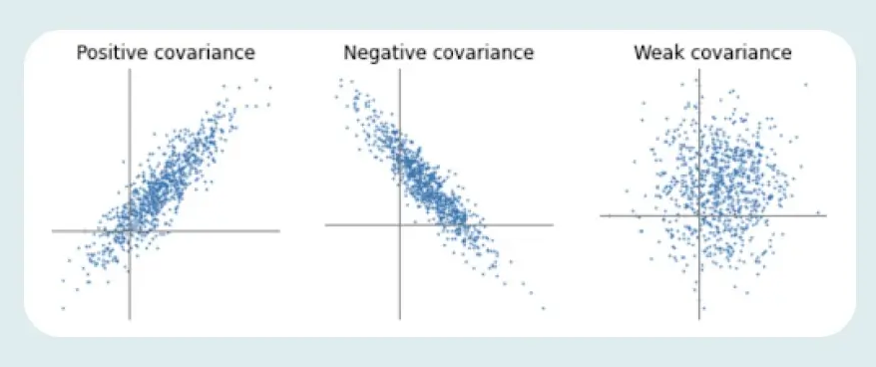
Covariance
measure of the linear association between two variables (measures how changes in one variable are associated with changes in another variable)
positive = variables tend to move in the same direction
does not provide a standardized measure and is sensitive to the units of the variables

Slide 22
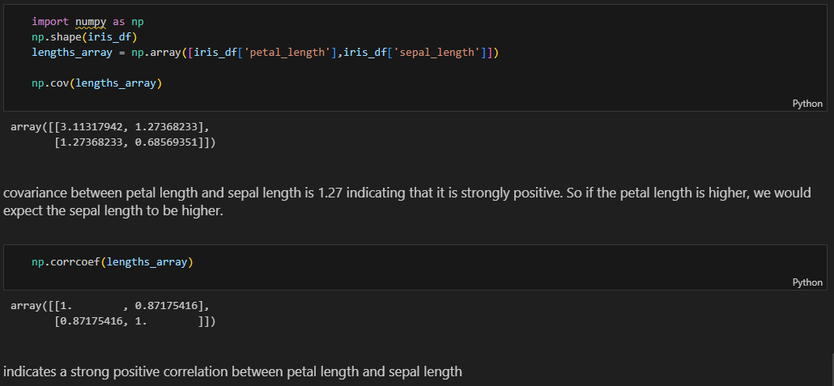

Slide 23
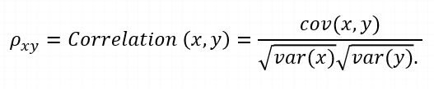

 | Covariance | Correlation
 | Let Σ(X) and Σ(Y) be the expected values of the variables, the covariance formula can be represented as:
Where, | xi = data value of x yi = data value of y x̄ = mean of x ȳ = mean of y N = number of data values | var(X) = standard deviation of X var(Y) = standard deviation of Y
Definition | Covariance is an indicator of the extent to which 2 random variables are dependent on each other. A higher number denotes higher dependency. | Correlation is a statistical measure that indicates how strongly two variables are related.
Values | The value of covariance lies in the range of -∞ and +∞. | Correlation is limited to values between the range -1 and +1
Change in scale | Affects covariance | Does not affect the correlation
Unit-free measure | No | Yes

